Slide 1


To Find the Frequency of the AC Mains With a Sonometer
Arpit Agarwal

Slide 2


Aim
To find the frequency of the AC mains with a sonometer.
Apparatus
A sonometer (with soft iron wire), a set of eight tuning forks, ½ kg hanger, seven ½ kg slotted weights, clamp, stand, rubber pad, paper rider, metre scale.

Slide 3

Theory
Let the alternating current have frequency v so that the frequency of magnetisation of the electromagnet (${ v}_{E}$ ) becomes 2v.
Let a loaded stretched soft iron wire have resonant length l1 with the electromagnet. Let a tuning fork of frequency $v_{T}$ have resonant length l2.
Then from law of length
${ v}_{E}$ $l_{1}$=$v_{T}$ $l_{2}$
$v_{E}$ = $v_{T}$ $l_{2}{/l}_{1}$
Hence, frequency of alternating current,
v =1/2 $v_{E}$ =1/2 $v_{T}$ $l_{2}{/l}_{1}$
Which can be calculated

Slide 4

The natural frequency of oscillation for a stretched wire of length L and mass m and tension T is
n=1/2L $\frac{\sqrt{T}}{\sqrt{μ}}$
Here, $μ=\frac{mass}{length} =\frac{m}{L}$

Slide 5


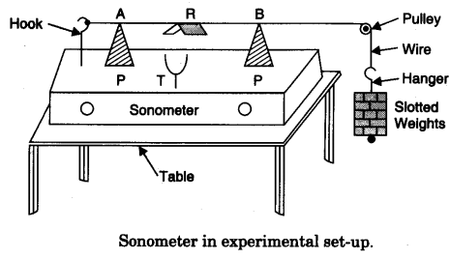
Diagram

Slide 6

Procedure
Place the sonometer on the table as shown in figure.
Test the pulley and make it frictionless by oiling (if necessary).
Put suitable maximum weights in the hanger.
Move wooden bridges P, P outward to include maximum length of wire (AB) between them.
Decrease the length of the wire by moving both the bridges equally inwardly.
Go on decreasing the length till sonometer wire starts vibrating (a sound is heard).
Adjust the length for maximum amplitude of vibration, (maximum sound).
Measure the length of the wire AB between the edges of the two bridges and record it in ‘length decreasing’ column.

Slide 7

Bring the two bridges closer and then adjust the length for maximum amplitude by increasing it.
Measure the length and record it in length increasing’ column.
Now take a tuning fork of minimum known frequency (say 256) and adjust wire length with the vibrating tuning fork.
Repeat step 11 above with tuning forks of other known frequencies 288, ……. 512.
Record your observations.

Slide 8
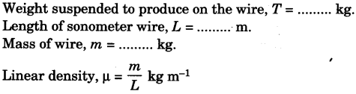
Observation

Slide 9
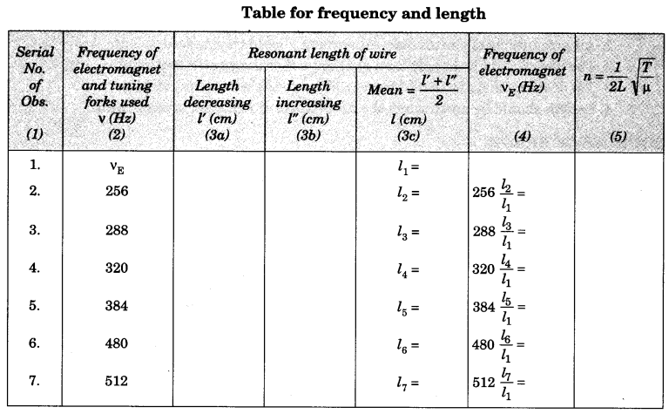
Observation Table

Slide 10
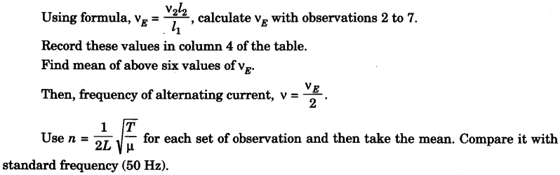
Calculation

Slide 11
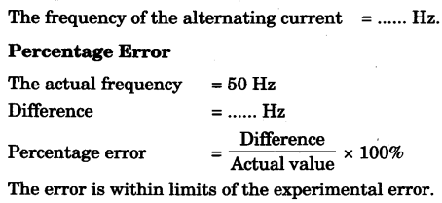
Result

Slide 12
Precautions
All precautions of sonometer experiment should be observed.
The wire should be of soft iron or of any other magnetic material.
Tip of electromagnet should be very close to the wire in its middle*
Length should be noted when the amplitude of vibration is maximum.
Sources of error
Wire may not be rigid and of uniform cross-sectional area.
Pulley may not be frictionless.
Weights may not be correct.
Knife edges (bridges) may not be sharp.
The main frequency may not be stable

Slide 13

……………..
……………..
…………….

